Slide 1
Import c4d
Python PH Show and Tell

Slide 2

Hi! Francisc Jerhone Camillo a computer engineering student from PUP-Sta. Mesa, Manila Data Science (python)[newbie] | Internet of Things | 3D Graphics (Cinema 4D)

Slide 3
Show and Tell
What is it about?
What do I have now?
What I want to create?

Slide 4
Brief Introduction in Cinema 4D and c4d
Cinema 4D is a 3D Modelling, Animation, Rendering platform
Uses Python, C.O.F.F.E.E. For fast production, asset utilization and plugin creation
Using the c4d module we can interact with the various elements, primitives, objects inside cinema 4D

Slide 5
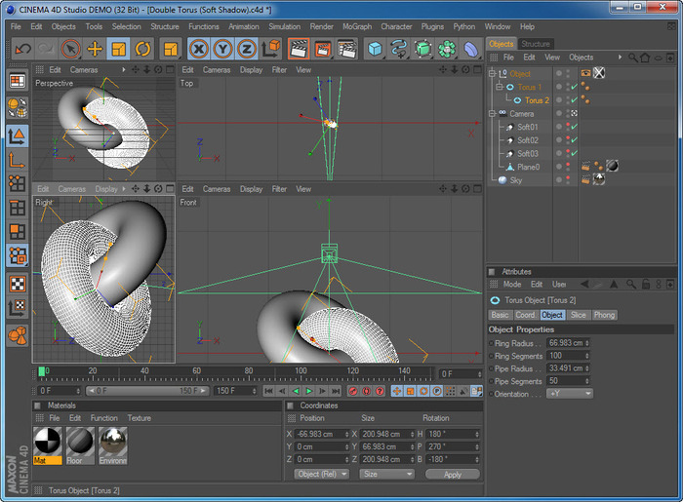

Slide 6
What is it about?
Using c4d package we can work with different assets inside cinema 4D
Target: Experiment with the different objects using the package

Slide 7
Let’s see the code

